Slide 1
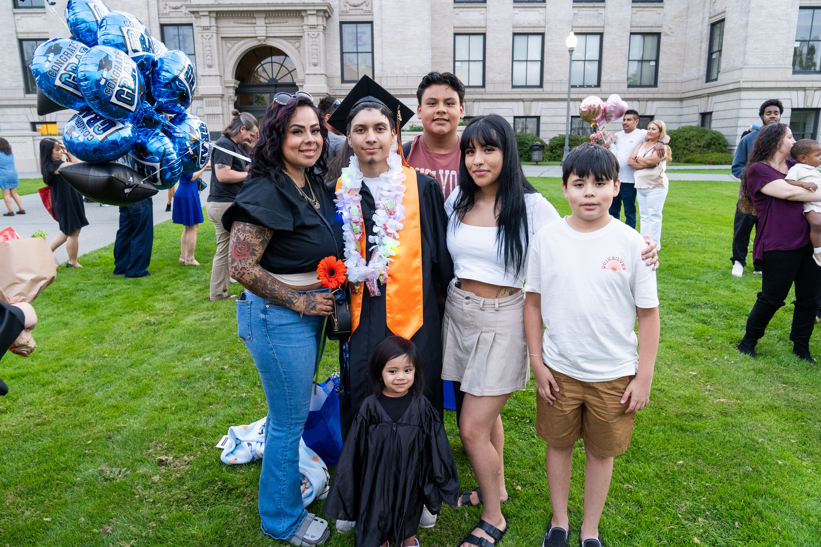

CCR/OTG
Counselor Update
EVERETT PUBLIC SCHOOLS
January 16, 2025

Slide 2
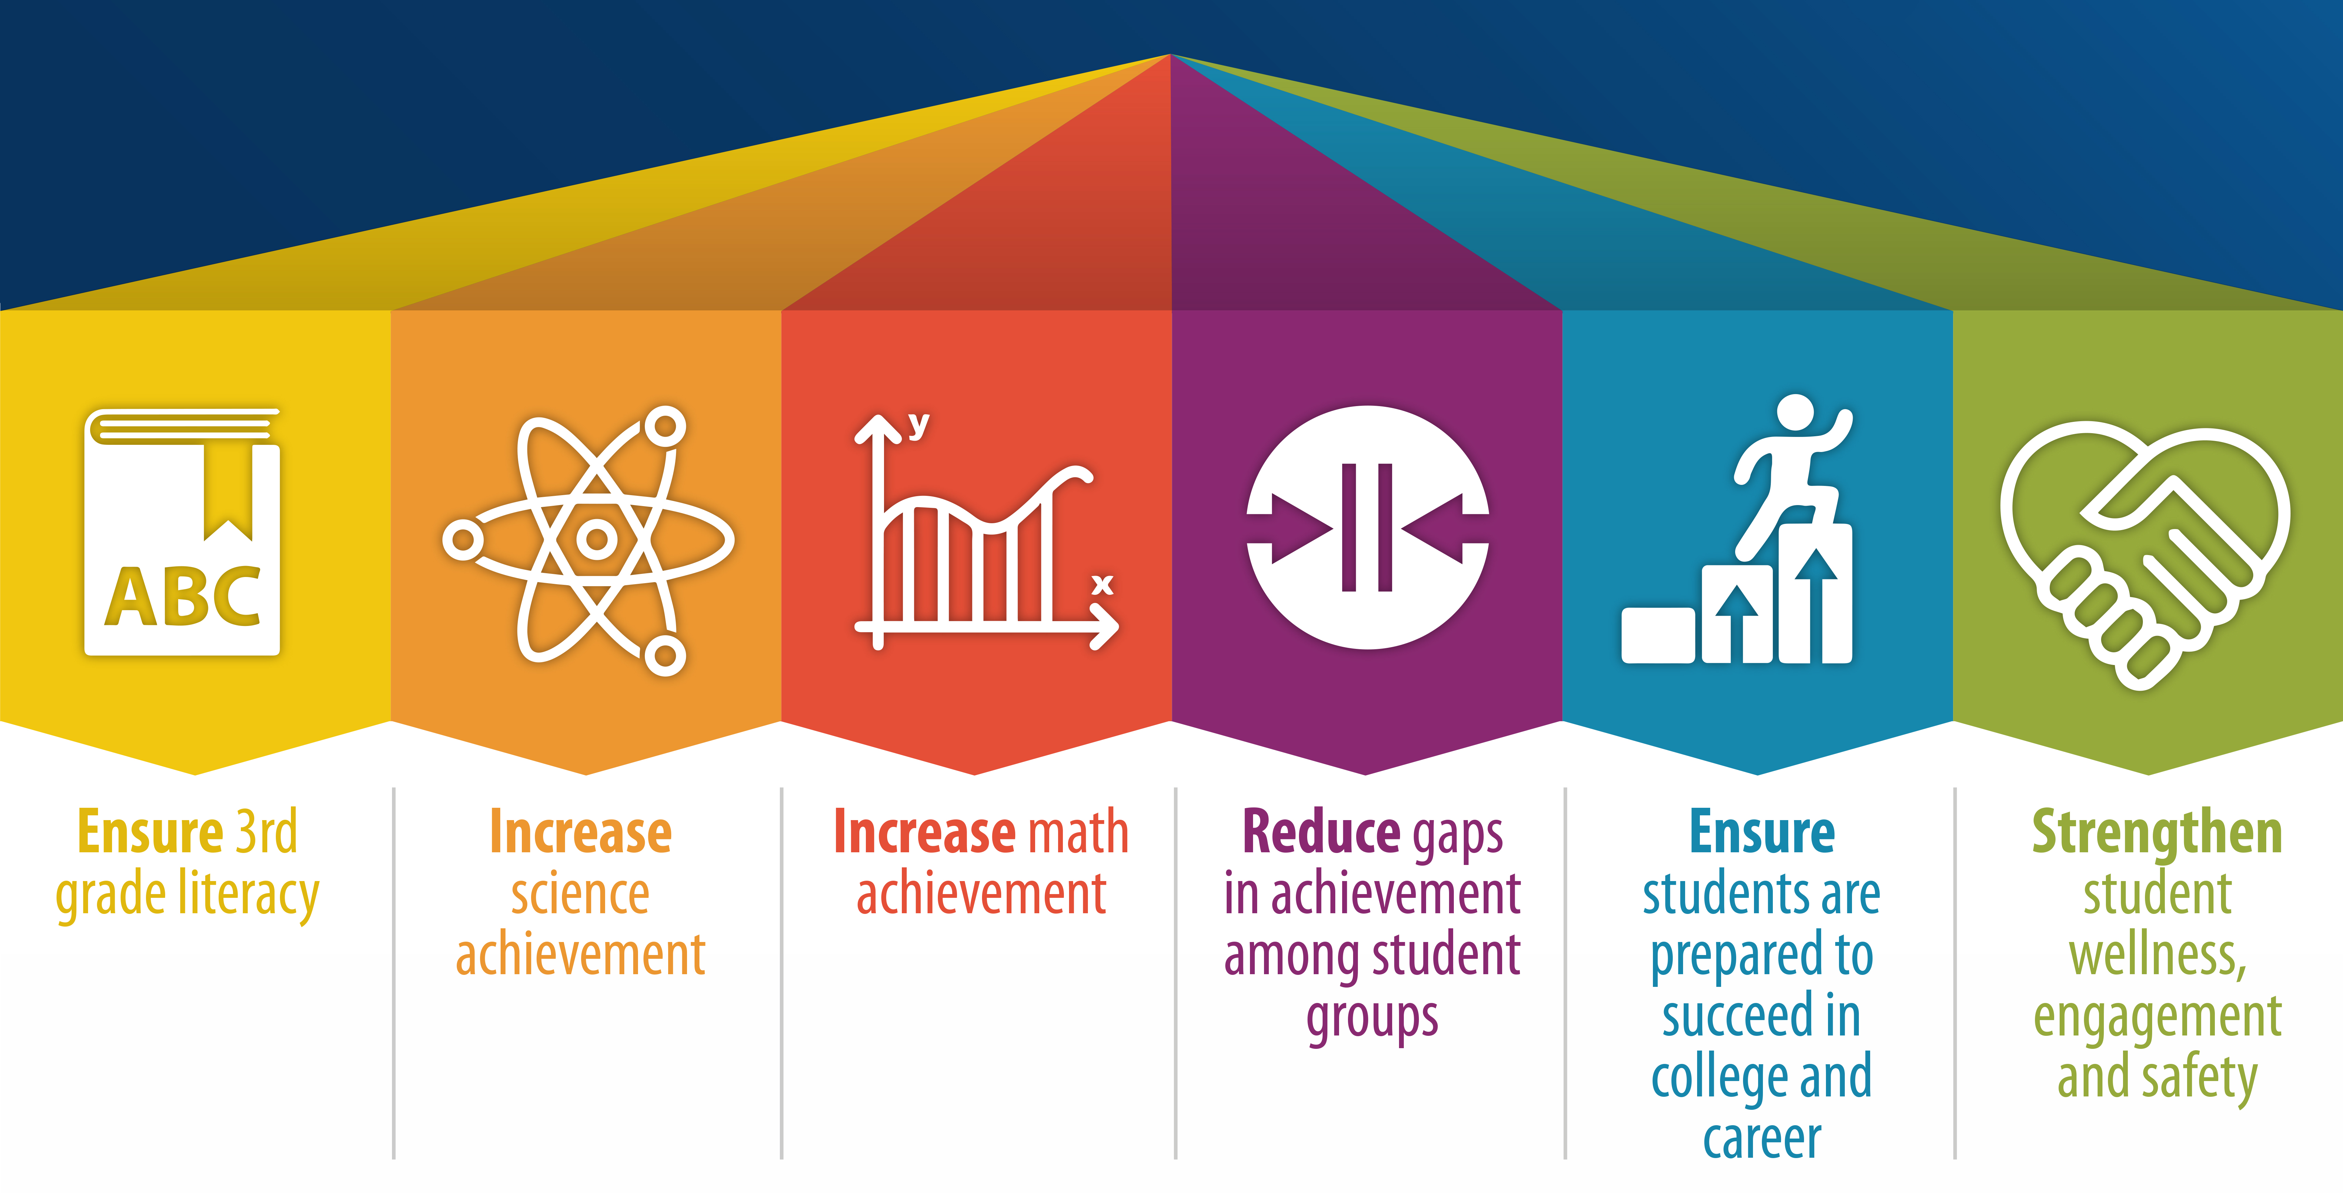

Strategic Plan Priority Student Outcomes

Slide 3
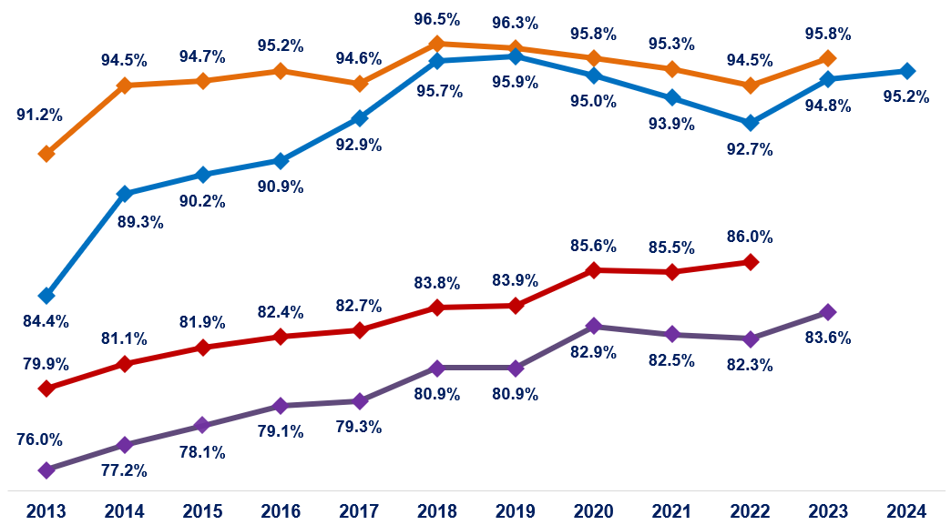
Graduation Rates, Classes of 2013 – 2024
Everett Public Schools
5 Year Rate
Washington State
4 Year Rate
5 Year Rate
4 Year Rate

Slide 4


Course Catalog Preview
High School Course Catalog Highlights
Middle School Course Catalog Highlights
High School Course List
Middle School Course List
Ninth Grade Course Options
Course Equivalency List of Approved Courses
Delivery of catalogs
Notes:
In the first semester of senior year,
Red means 15 or fewer credits
Yellow means more than 15 and less than 18
Green means 18 or more credits

Slide 5
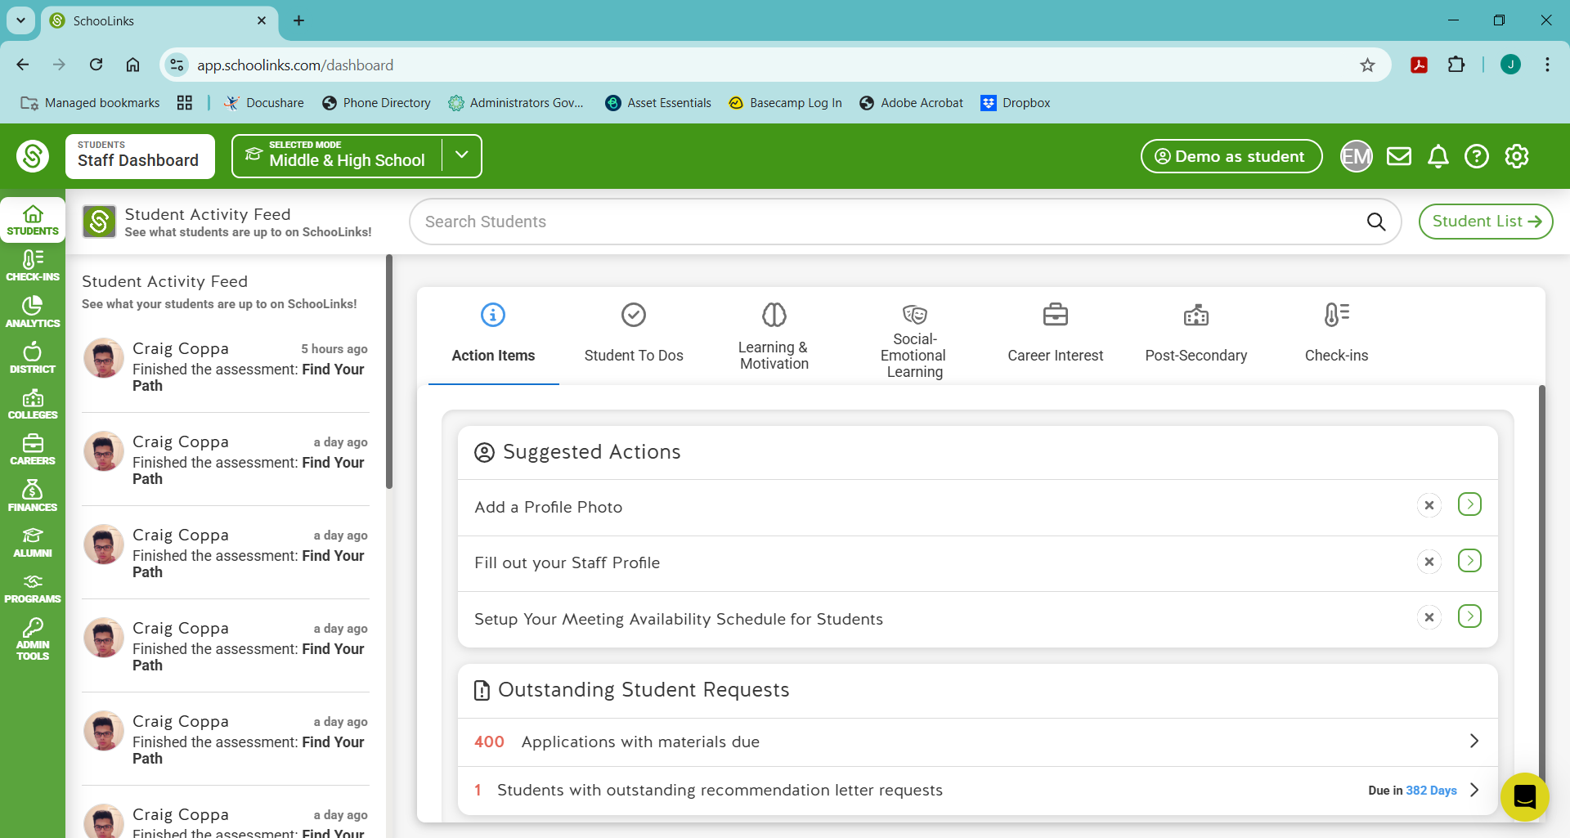
Universal HSBP Tool – SchooLinks – Fall 2026

Slide 6
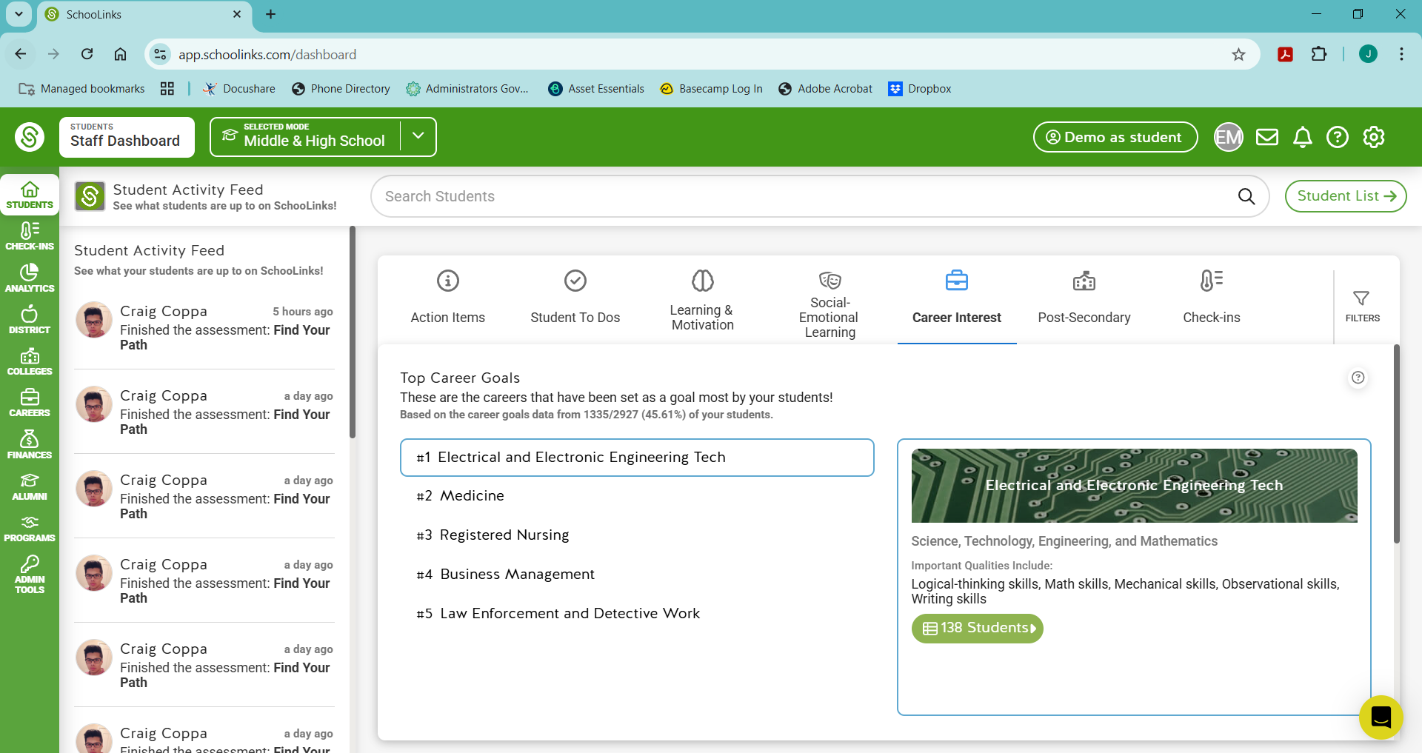
Universal HSBP Tool – SchooLinks – Fall 2026

Slide 7
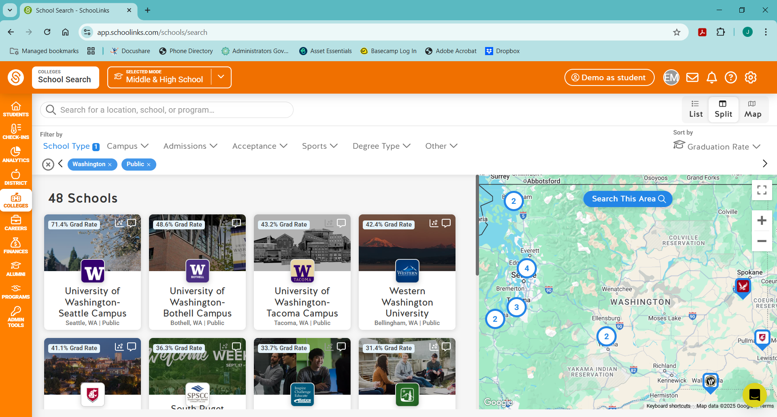
Universal HSBP Tool – SchooLinks – Fall 2026

Slide 8
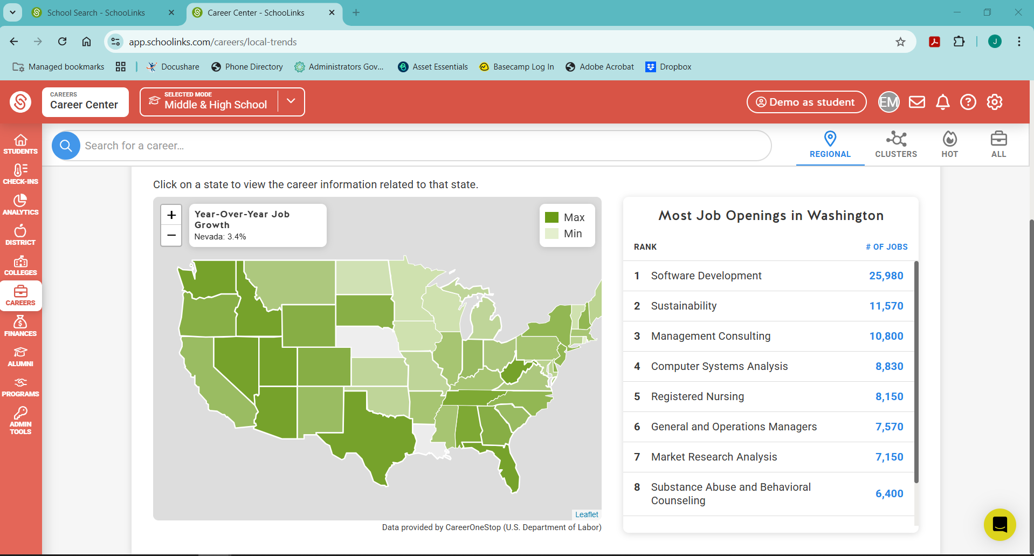
Universal HSBP Tool – SchooLinks – Fall 2026

Slide 9

Thank you!

